Slide 1



Social Media
Data Analysis
Identifying Most Loyal and Active Users
Submitted By:
Sumit Kumar Sharma

Slide 2




Overview
About Social Media
Introduction & Objectives
Data Overview
Important Data Attributes
Insights From Data Analysis
Dashboard
Conclusion

Slide 3
About Social Media
Social media is a platform for sharing photos, videos, and stories, allowing users to connect, follow others, and engage through likes, comments, and direct messages. It features hashtags for content discovery, offers filters for enhancing posts, and supports influencer marketing. Additionally, users can share temporary stories and explore content based on their interests.

Slide 4


Introduction
Identifying user engagement level and activity level
MySQL and Power bi have been used to analyse and visualise various facets of database.
Objectives of analysis
Determining Most Frequent Tags
Identifying Users who can have a greater influence on other users

Slide 5



Data Overview
01
Total number of Users:- 100
02
Total Posts:- 257
03
Total Likes and Comments are 8782 and 7467 respectively
04
Total tags in database- 21
05
Top 5 frequently used tags- Smile, beach, Party, Fun, and Concert.
06
Total tables in database-7

Slide 6



Important Data Attributes
The data that has been analysed contains many attributes that are important for analysis.
comments_id : unique identifier for each comment
comment_text : text content of a given comment
user_id : unique identifier for each user
photo_id : unique identifier for each photo
created_at : date of interaction in the form like, photos, tags
follower_id : user_id of the follower for a certain user
followee_id : user_id of followee for a certain user
tag_id : unique identifier for each tag
image_url : link to the image posted on the platform
username : username chosen by the user

Slide 7
Methodology
Data sanity- Data sanity such as blank rows, and duplicate rows was checked using various queries SQL queries.
Analysis using MySql-
a). Different tables were joined using Left join, Right join, Inner join, and others, based on their primary keys for a better and quick analysis.
b). Various calculations such as averages, sums, counts and others using group by were made within the queries for data analysis.
c). Functions such as window functions which included rank, dense rank, and row number were used to rank users based on different attributes. In addition, CTE (common table expression) was also used in many queries.
d). Various columns were renamed within queries for a better understanding.
e). Many tables were extracted based on the objective of the analysis.
Analysis and Visualization of data in Power BI-
a). Tables were transformed and loaded into the power bi and connected with each other using manage relationship tool in power bi.
b). Various calculated measures and columns were added to the analysis for a better analysis.
c). Appealing features of power bi such as drill through, drill down, edit interaction, and others were used for making the report more dynamic and informative.
Visualization-
A dynamic dashboard with many visualizations depicting different types of insights were made in the power bi.

Slide 8
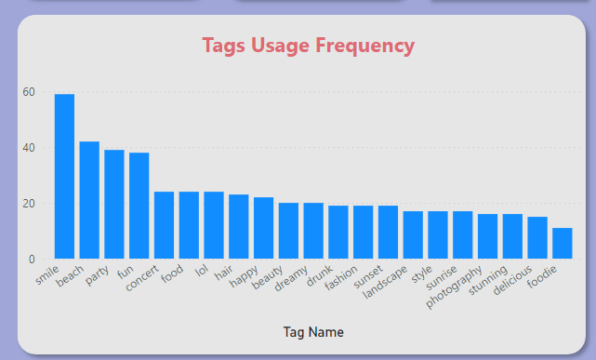
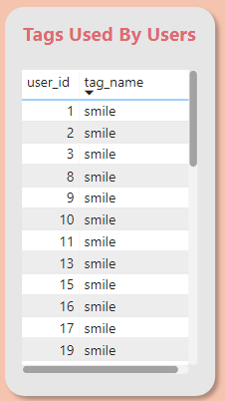
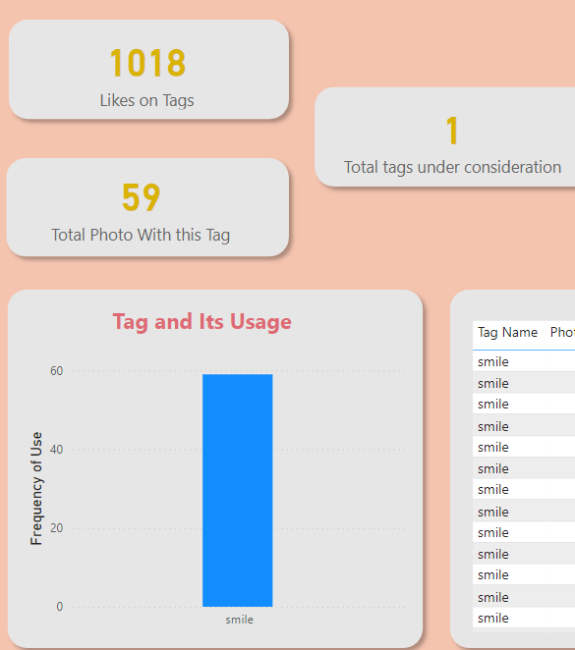
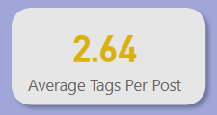
Tag Data
Smile, Beach, Party, Fun, and Concert are the top 5 tags used most frequently.
The tag ‘smile’ has been used by many users as shown in the ‘Tags used by users’ table.
Smile tag was used in 59 posts, which received a total likes of 1,018.
Average tags per post is 2.64

Slide 9
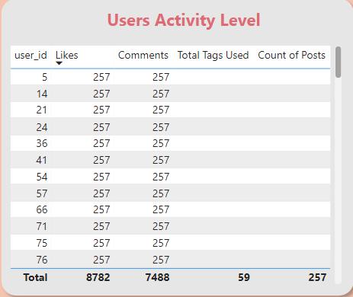
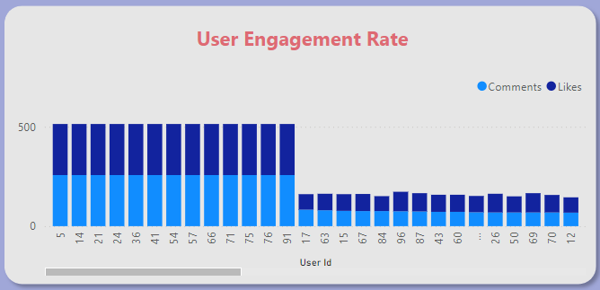
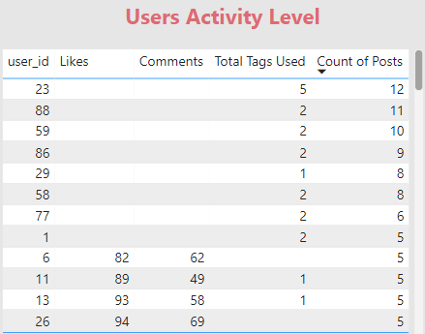
User activity and Engagement Level
User IDs-5,14,21,24,36,41,54,57,66,71,75,76, and 91 have not posted any photos, however they have the most number of likes and comments.
On the other hand, User IDs such as 23, 88, 59, 86, 29, 58, 77, and 1 have posted most number of photos but didn’t like or comment on any posts.

Slide 10
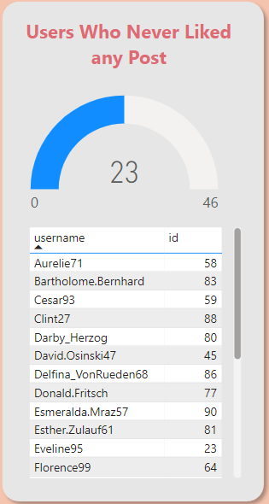
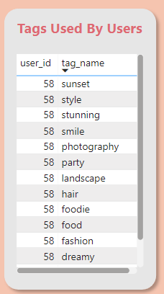
User who have never liked any post
There are 23 users who have not liked any post.
One of these users for example user id 58, has used the tags such as sunset, style, stunning, smile, and many others in its posts as shown in the second table.
To increase the level of activities from these users, posts with the tags that they used in their posts shall be shown. They will be more likely to like such posts.

Slide 11
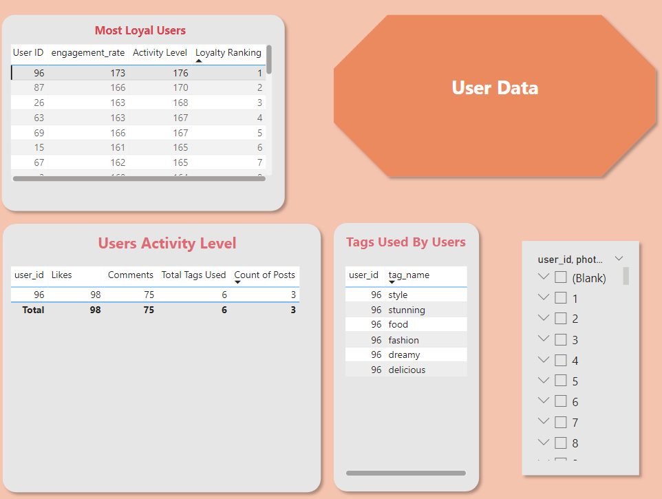
Loyal Users
User IDs such as 96,87,26,63, and 69 are the top 5 most loya users with high activity level and engagement rate.
The most loyal user that is user id 96, has done 98 likes, 75 comments, used 6 tags, and posted three photos.
The tags used by user id 96 are style, stunning, food, fasion, dreamy, and delicious.

Slide 12
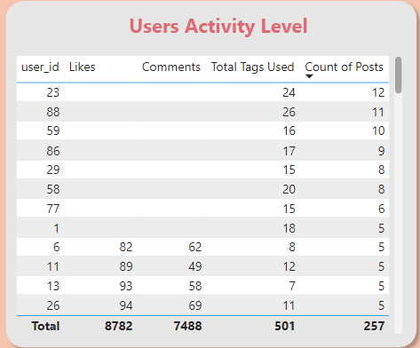
Ideal User for Influencer Marketing
User IDs such as 23, 88, 59, 86, 29, 58, 77, and 1 have posted most number of photos and used most tags.
These users are ideal for assigning influencer marketing campaign.

Slide 13
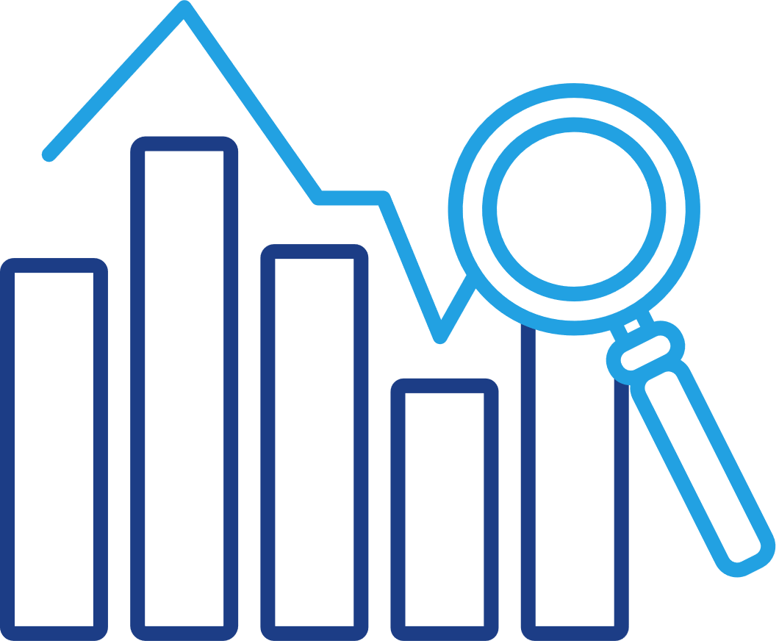
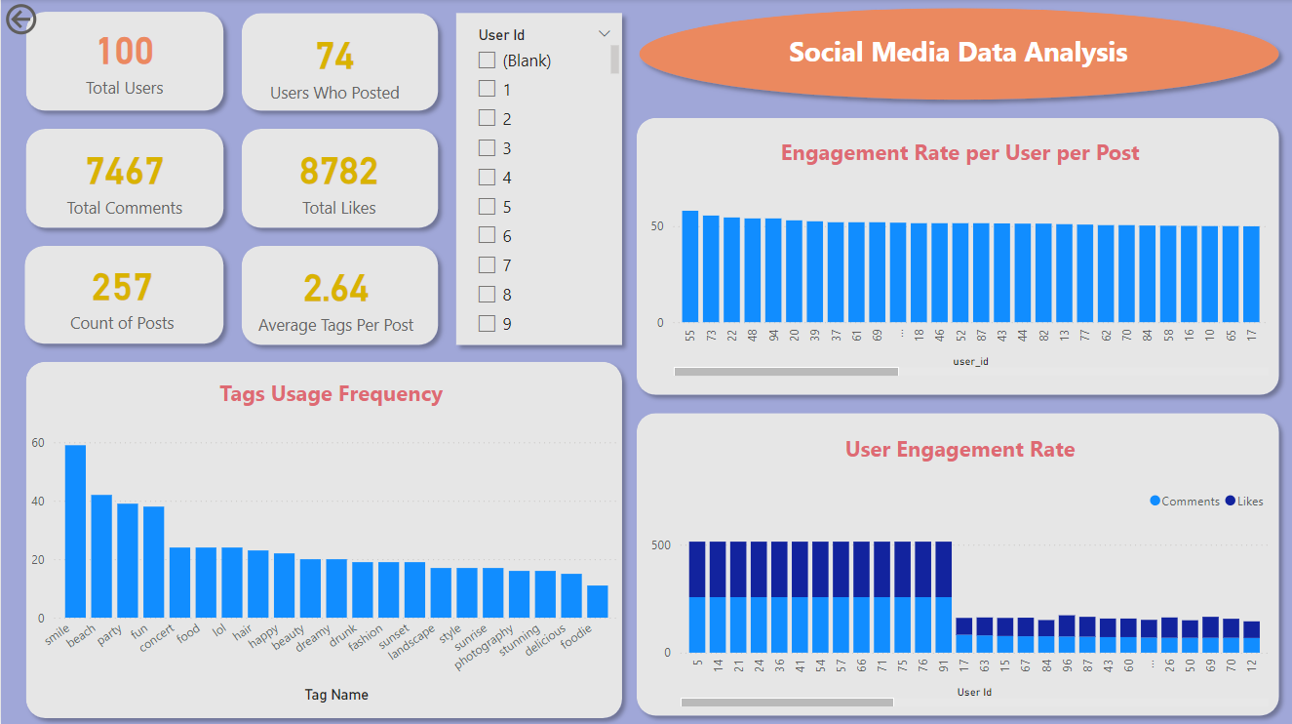
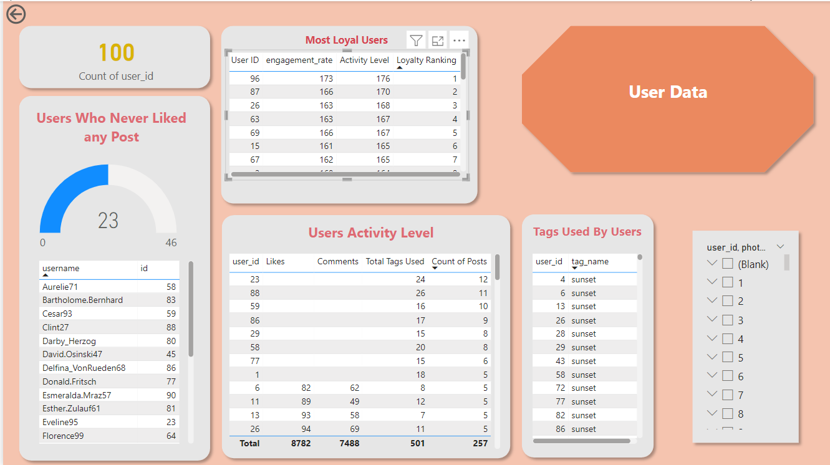
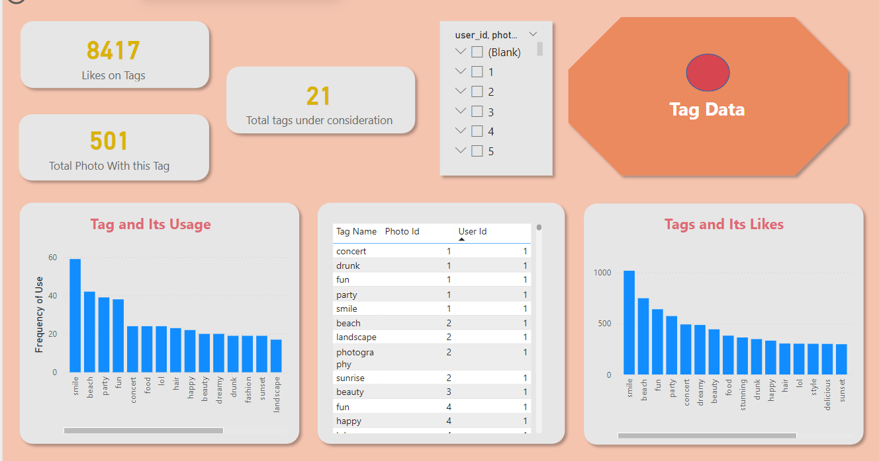
Dashboard

Slide 14
Conclusion
Identified user engagement level and activity level
Identified most frequent tags
Identified Users who can have a greater influence on other users
The through analysis of the data has enabled us to get various insights related to the users, their activity level, engagement level, most frequent tags, and much more.
The analysis has been successful in delivering the objectives that were to identify the most loyal users, tags used, and others required data.

